Slide 1

PlotBot – Story Generation Using Recurrent Neural Network
CSC-582 NCSU

Slide 2
Content
Motivation
Objective
User Interface and Interaction
Textgenrnn
Textgenrnn (Cont.)
Markovify
Combining methods
Screenshots

Slide 3
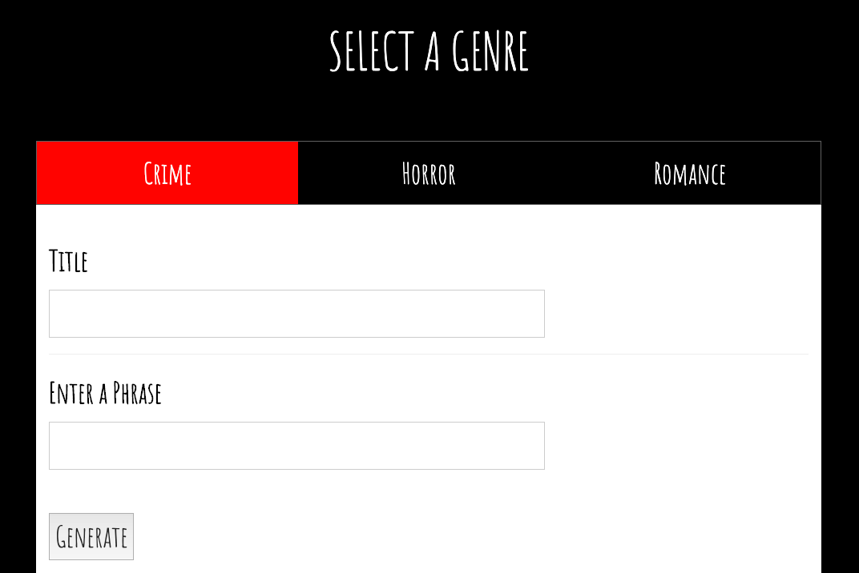
Objective
An interactive web page through which a user can generate their own short stories in accordance with the desired genre. Based upon the user-provided information and pre-defined plot skeleton, the RNN would generate the text.
PlotBot
Choose the genre and provide keywords
The web page would present appropriate text (story) with a soundtrack and gif
Figure 1: Genre and Keyword Selection

Slide 4
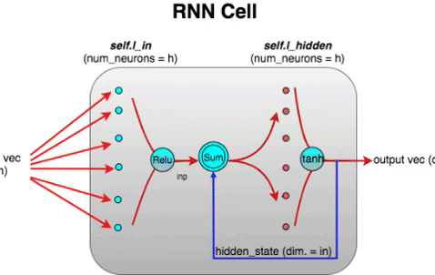
Motivation:
Neural Network
RNN where connections between nodes form a directed graph
B) Google Deep Dream
A Convolutional Neural Network via algorithmic pareidolia
C) Generate a story using machine
Automatically generate a story plot for film or paperback using key words of your choice
D) Assignment 4
Figure 2: Motivation

Slide 5
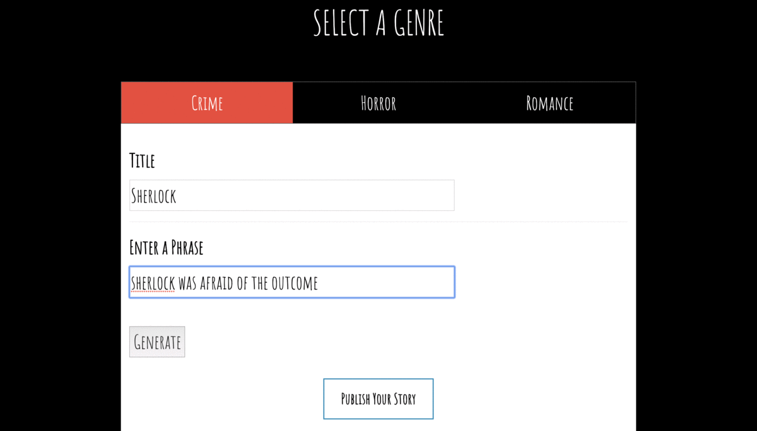
User Interface (Interaction)
Select a genre of your choice - Crime/ Horror/ Romance
Enter a phrase of your choice
Machines generates a narrative for you
Publish your story
Figure 3: User Interface Interaction

Slide 6
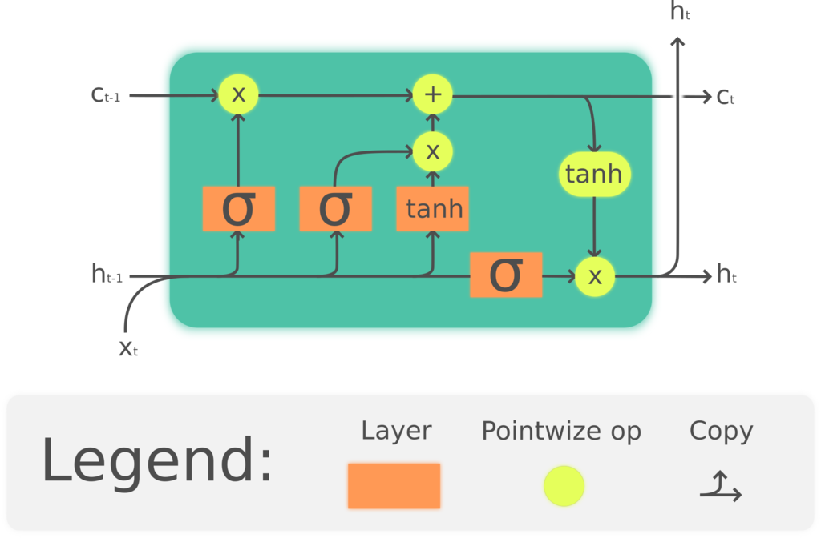
Textgenrnn
LSTM layers
Straightforward to train
Promising results
Word-level generation
But…
Figure 4: LSTM

Slide 7
Textgenrnn
LSTM layers
Straightforward to train
Promising results
Word-level generation
But…
Still not coherent sentences
Figure 4: LSTM

Slide 8
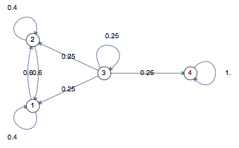
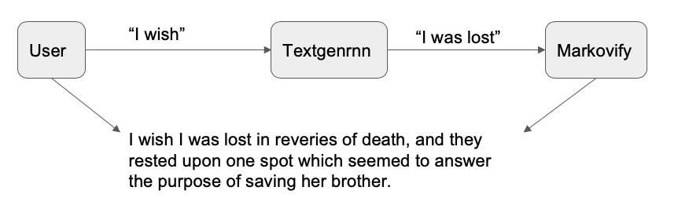
Generating Coherent Sentences
A) Markovify
Checks sentences for coherence
Works much better
Only works with known words
B) Combining methods
User inputs text
Textgenrnn generates the next few words
Generated text used as seed for markov chain
Markovify checks sentence quality
Figure 5: Process for
Coherent Sentences

Slide 9
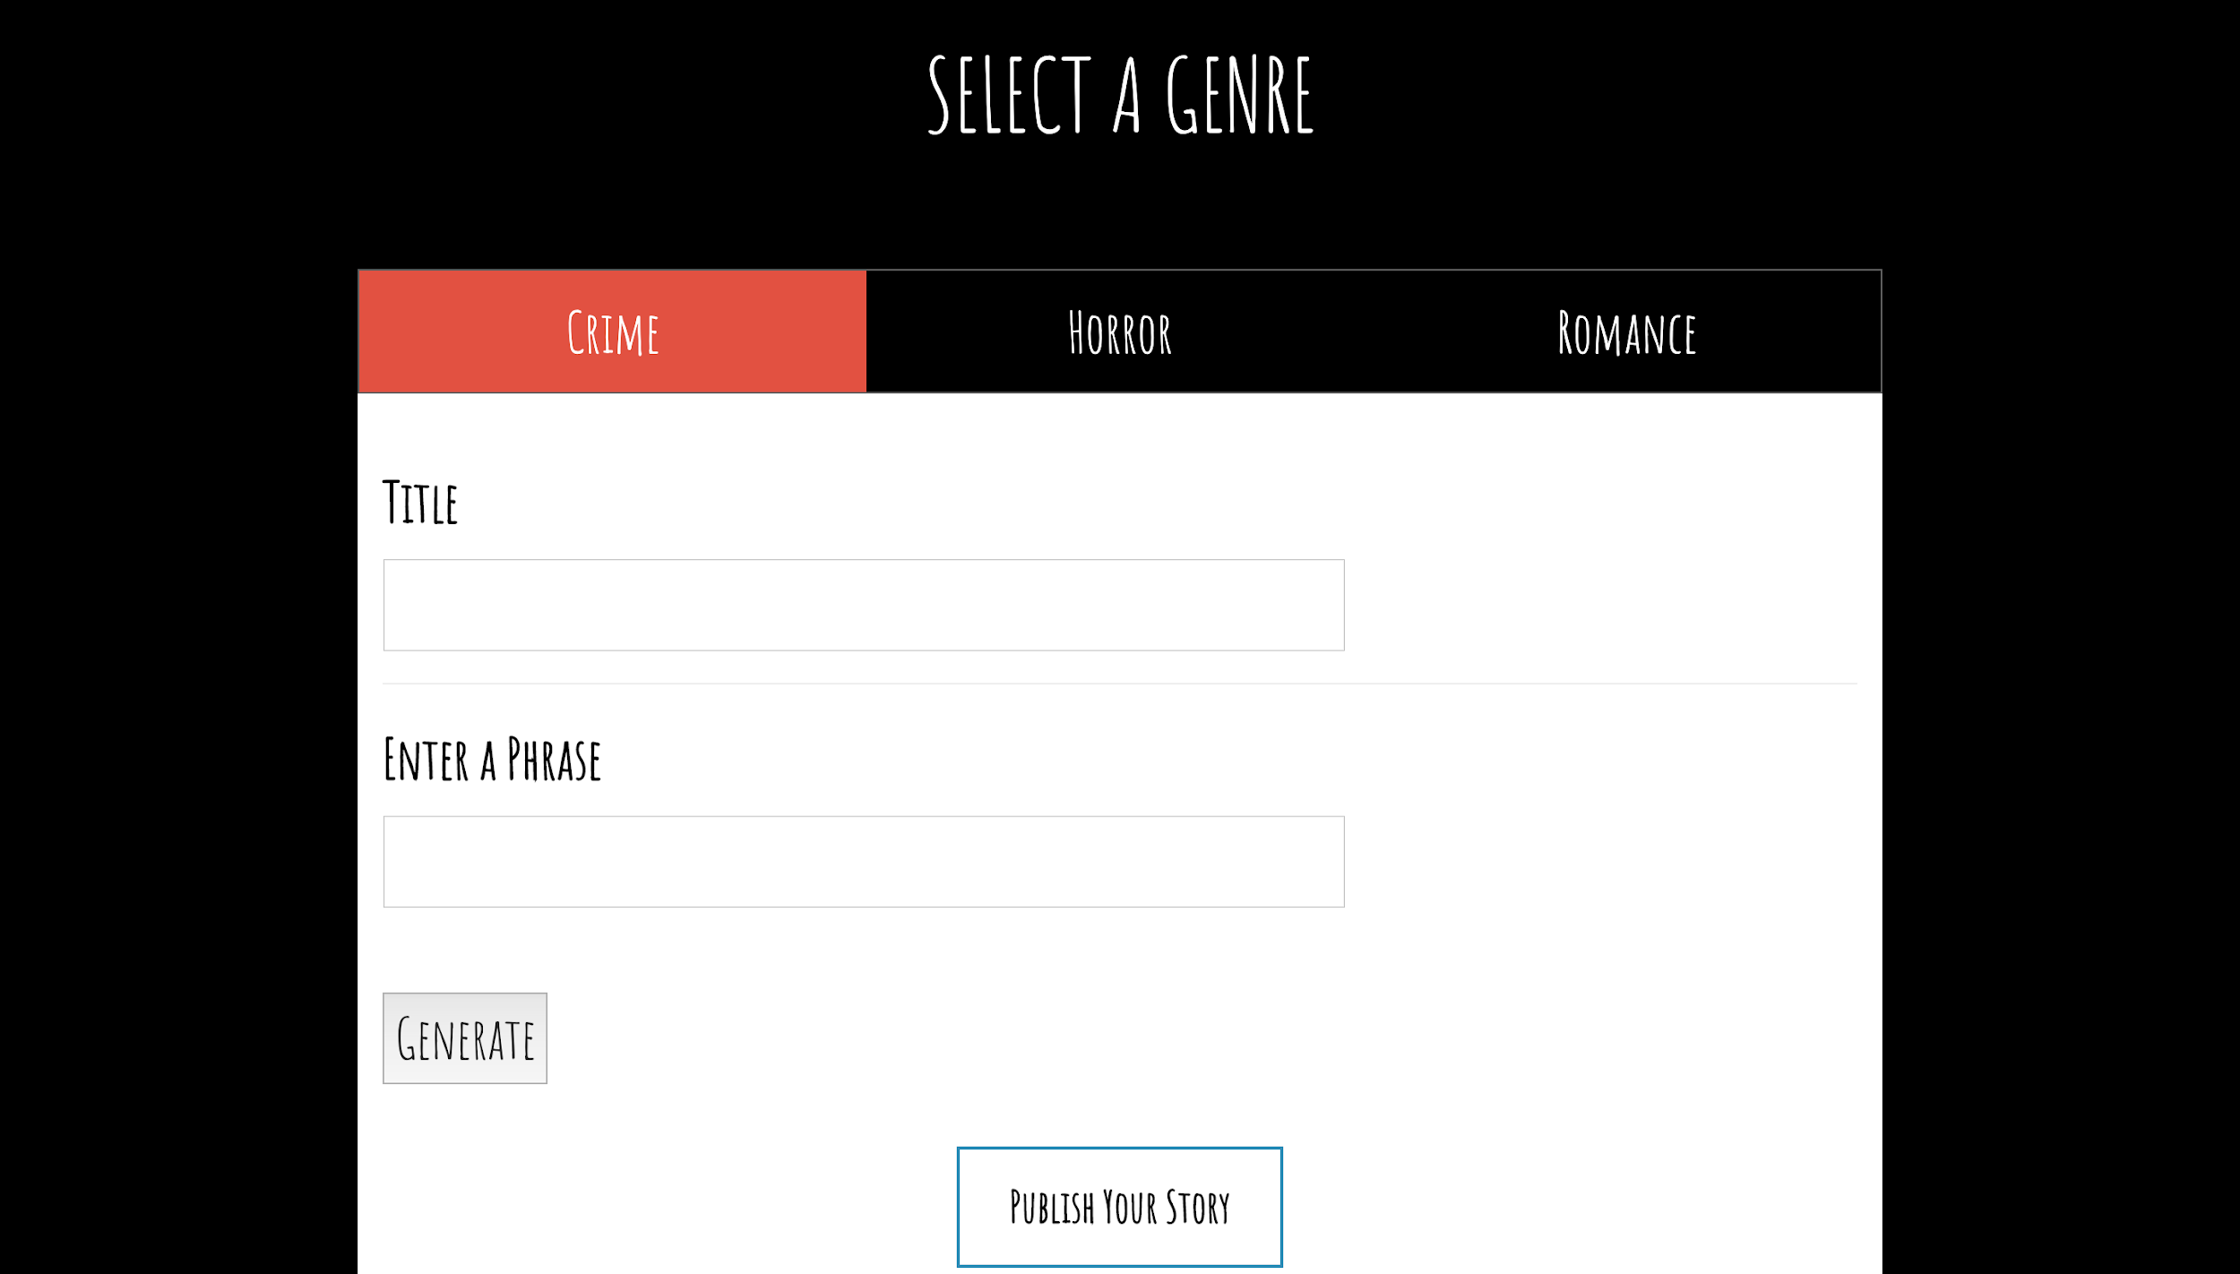

Slide 10
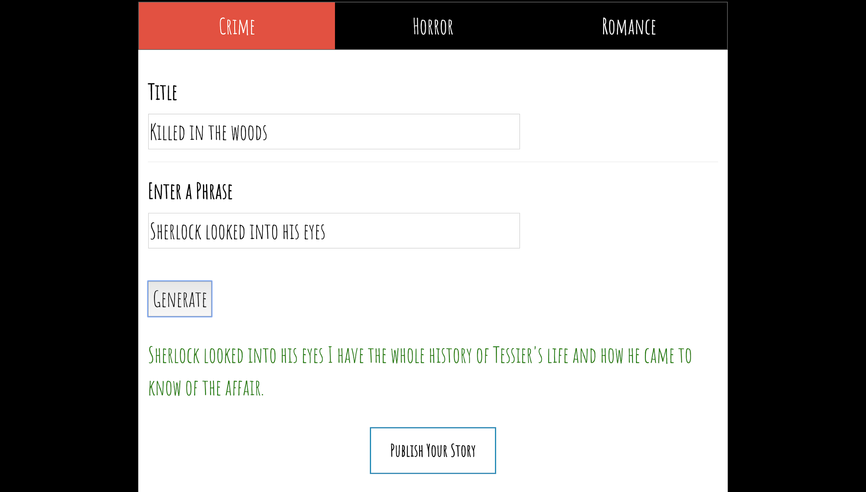

Slide 11
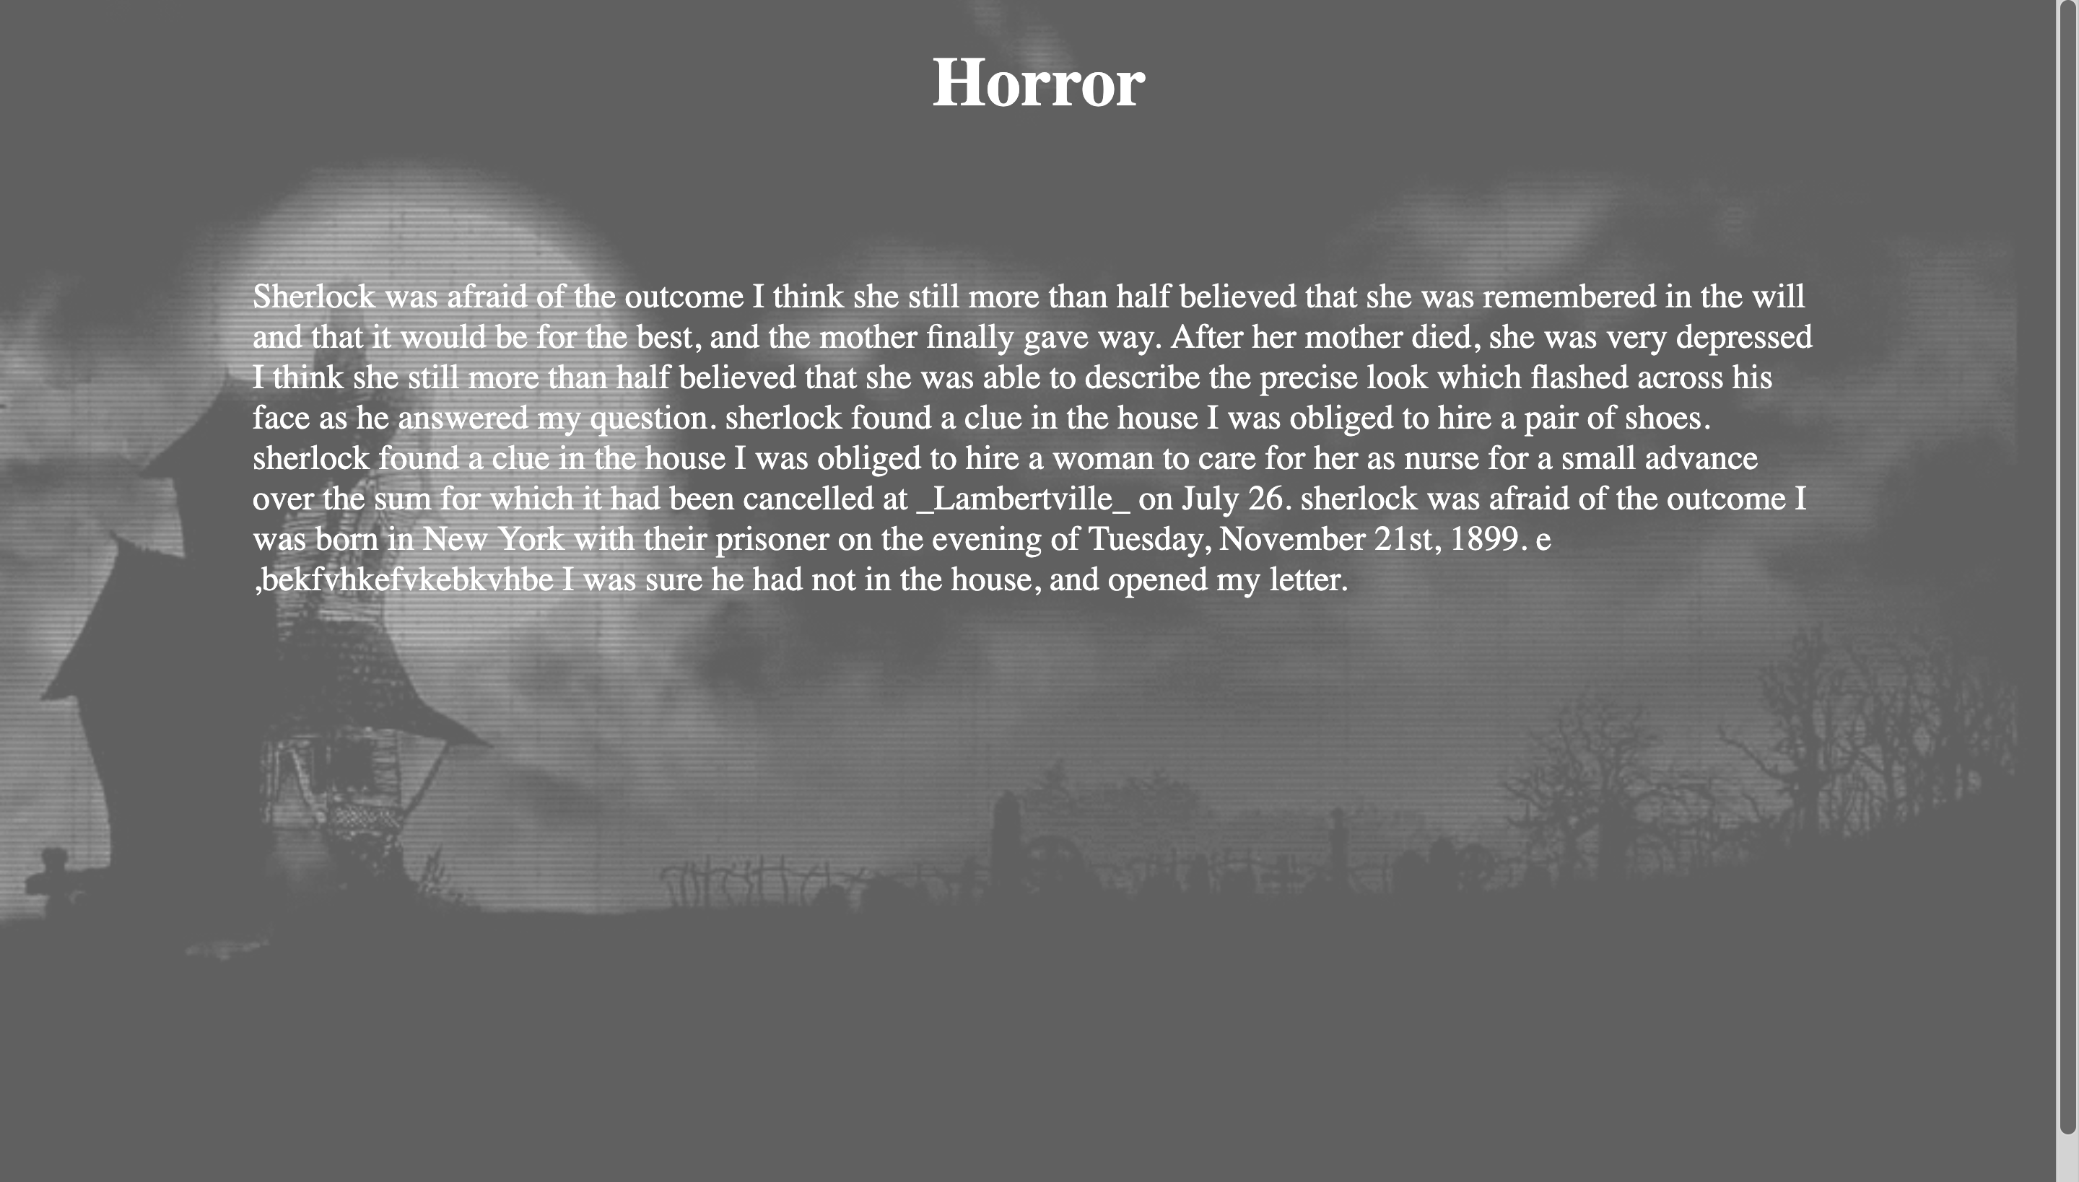

Slide 12

Thank You…

